Slide 1

ANJUMAN COLLEGE OF ENGINEERING AND TECHNOLOGY Affiliated To: Rashtrasant Tukdoji Maharaj Nagpur University, Nagpur (M.S.) Approved by: All India Council For Technical Education, New Delhi (India)
Department of Artificial Intelligence & Data Science
6th Semester Mini Project Seminar
Topic Name: Image Generation using GANs
Session 2023-24
Supervised By
Dr.Iram Nausheen
Assistant Professor
Industry Mentor
Neema Amish Ukani
NU Intelligence PVT Ltd
Presented By
Ishika Taklikar
6th Sem AI&DS

Slide 2

Content
Topis: | Pages :-
Introduction GANs | 3 4
Motivation | 5
Work Process/Work Done | 6
Flowchart | 7
Result & Conclusion | 8-9
References | 10

Slide 3

Introduction
Generative Adversarial Networks (GANs) are a powerful class of neural networks that are used for unsupervised learning.
GANs are made up of two neural networks, a discriminator and a generator.
They use adversarial training to produce artificial data that is identical to actual data.
The Generator attempts to fool the Discriminator, which is tasked with accurately distinguishing between produced and genuine data.
Generative models based on deep learning are common, but GANs are among the most successful generative models (especially in terms of their ability to generate realistic high-resolution images).

Slide 4
GANs
Generative Adversarial Networks (GANs) can be broken down into three parts:
Generative: To learn a generative model, which describes how data is generated in terms of a probabilistic model.
Adversarial: The word adversarial refers to setting one thing up against another. This means that, in the context of GANs, the generative result is compared with the actual images in the data set. A mechanism known as a discriminator is used to apply a model that attempts to distinguish between real and fake images.
Networks: Use deep neural networks as artificial intelligence (AI) algorithms for training purposes.

Slide 5

Motivation
1. Significance of Generative Modeling: Generative modeling plays a crucial role in unsupervised learning by uncovering patterns and structures within data without the need for explicit labels, offering valuable insights into complex datasets.
2. Potential of GANs in Realistic Image Generation: GANs are powerful tools with vast potential for generating highly realistic images. Their applications span diverse fields, including art, entertainment, and design, promising groundbreaking advancements in visual synthesis.
3. Interest in Anime Character Generation: A keen interest exists in the creation of anime characters, driven by a vibrant and passionate community. Leveraging GANs for this purpose offers a captivating blend of technology and creativity.
4. Desire to Explore GAN Capabilities: There is a strong desire to delve deeper into the capabilities of GANs in image generation tasks, fueling a journey of exploration and understanding to unlock their full potential.

Slide 6
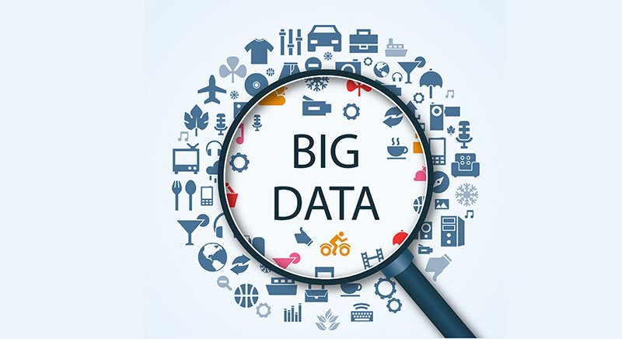

Work Process/Work Done
Discriminator is trained so actual data to classify whether given data is true or not, so Discriminator’s work is to tell what’s real and what’s fake.
Generator starts to generate data from a random input and then that generator data is passed to Discriminator as input now Discriminator analyzes the data and checks how close it is to be classified as real, if the generated data does not contain enough feature to be classified as real by Discriminator , then this data and weights associated with it are sent back to Generator using backpropagation.

Slide 7

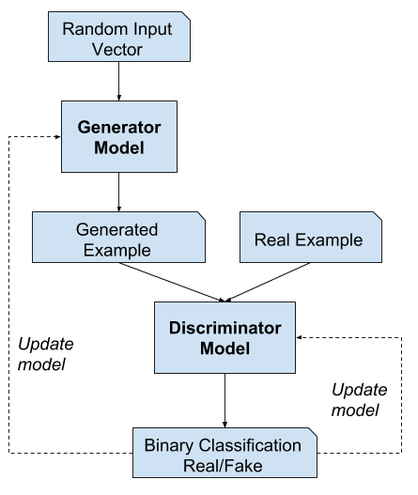
Flowchart
Using a GPU for faster training
Downloading and Exploring the Data
Introduction to Generative Modeling
Introduction to Discriminator Modeling
Activation Function
1) ReLU for discriminator
2) TanH for generator
Training the Generator
Training the Discriminator
Loss Function for Accuracy

Slide 8
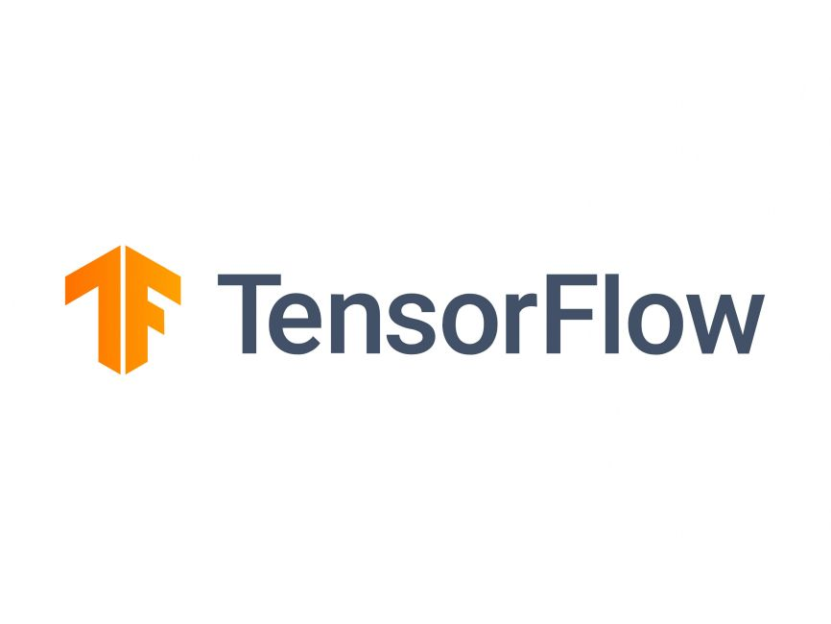
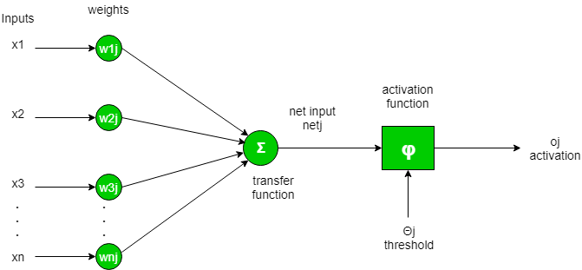
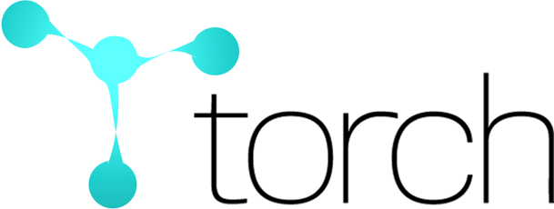
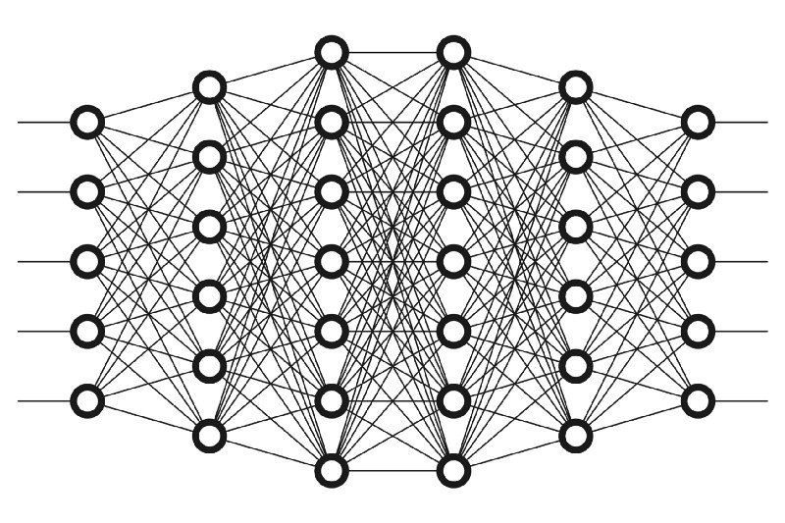
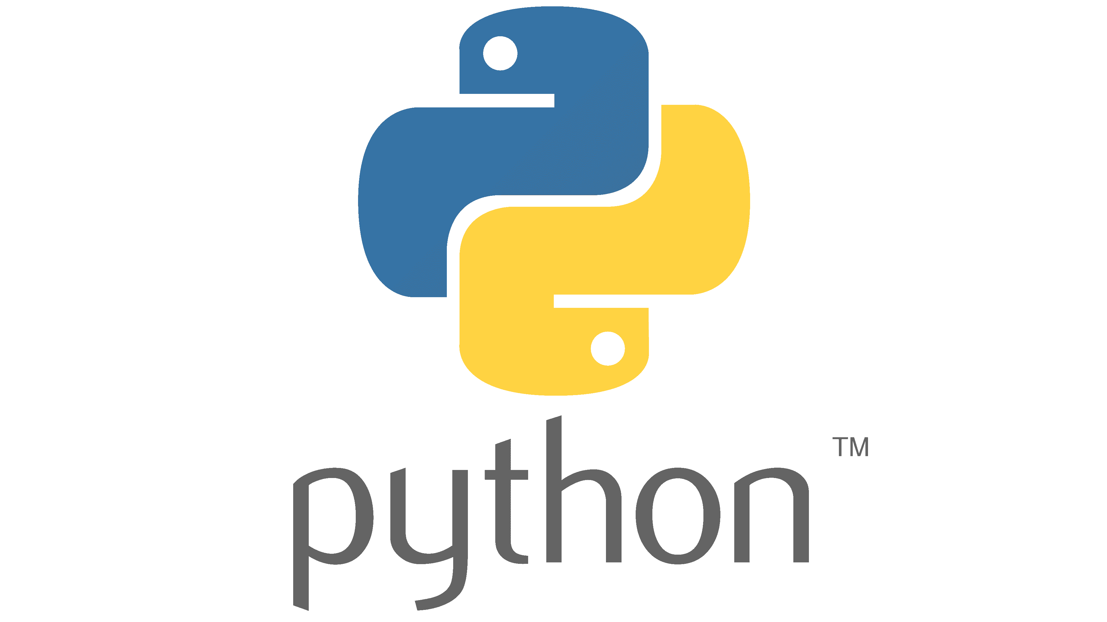
Technology Stack

Slide 9

Result & Conclusion
Since the outputs of the generator are images. We generate a batch of images using the generator, pass the into the discriminator.
We calculate the loss by setting the target labels to 1 i.e. real. We do this because the generator's objective is to "fool" the discriminator.
We use the loss to perform gradient descent i.e. change the weights of the generator, so it gets better at generating real-like images to "fool" the discriminator.

Slide 10
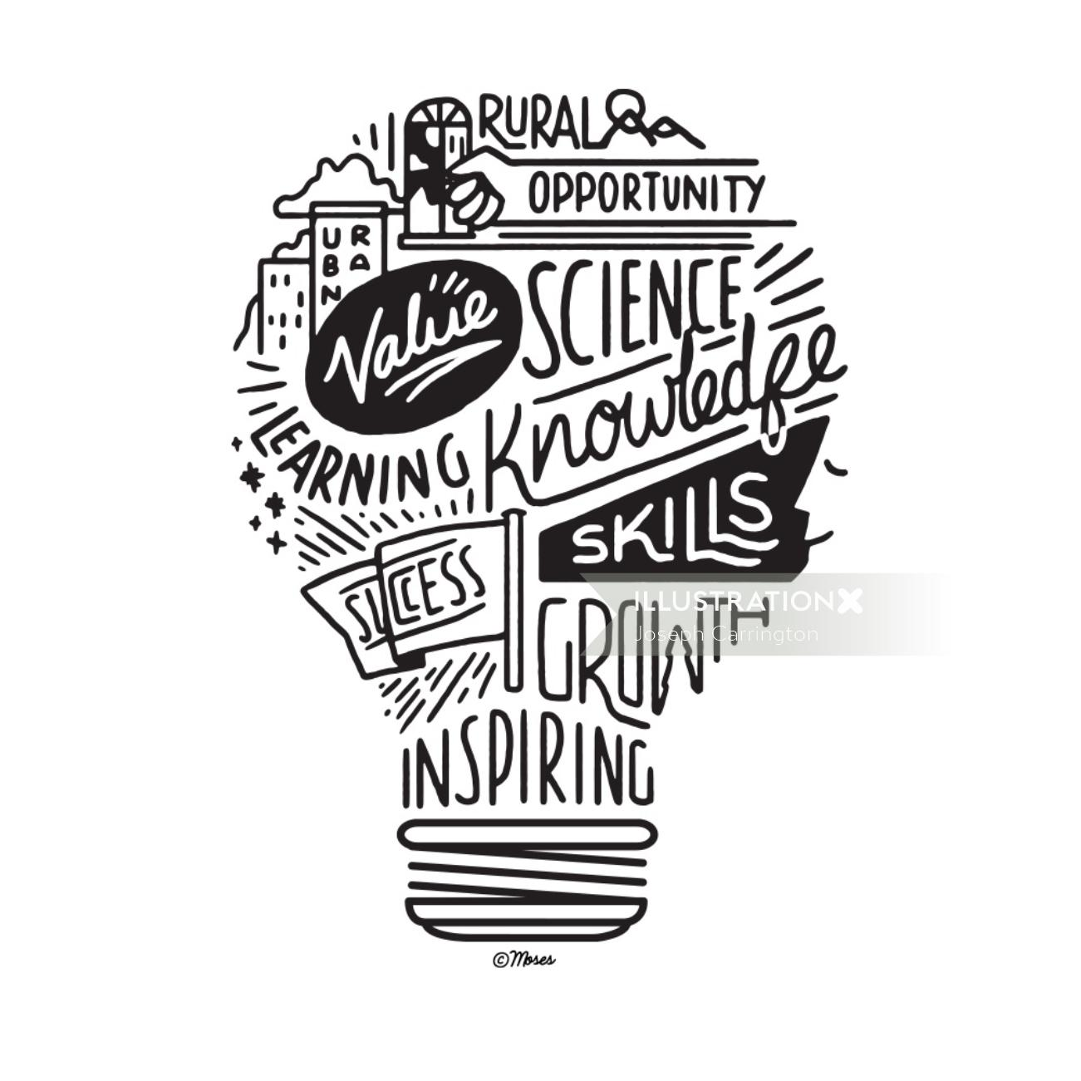
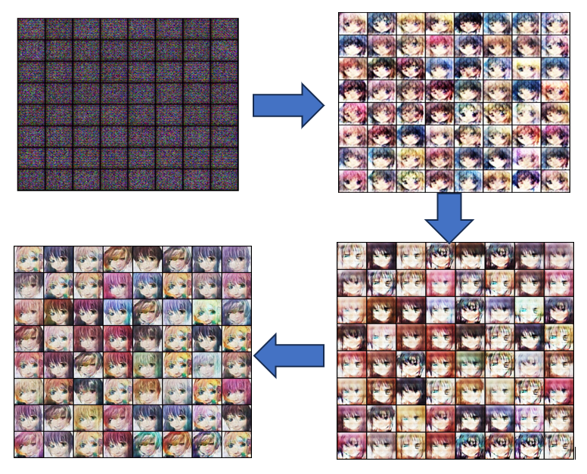
Result & Conclusion

Slide 11
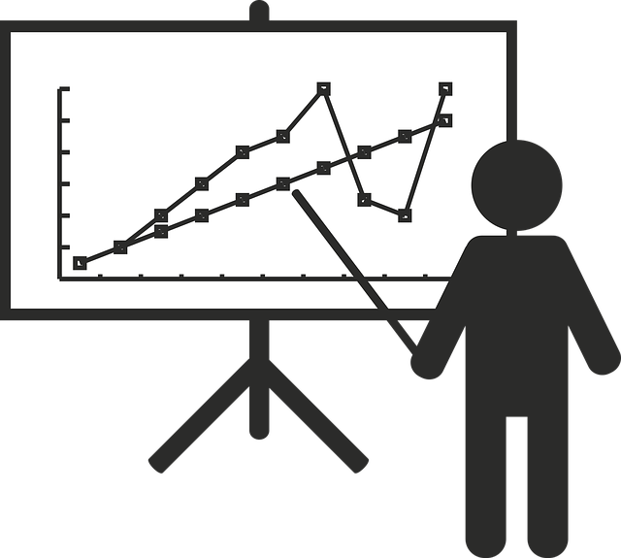
Reference
https://machinelearningmastery.com/what-are-generative-adversarial-networks-gans/
https://github.com/bchao1/Anime-Face-Dataset
https://www.kaggle.com/datasets/splcher/animefacedataset
https://sthalles.github.io/advanced_gans/
https://github.com/vdumoulin/conv_arithmetic/blob/master/README.md#transposed-convolution-animations
https://www.geeksforgeeks.org/generative-adversarial-network-gan/
https://youtu.be/79IvwU3G5_Q?si=XF-R4Jn0npe9FTW1
https://stackoverflow.com/questions/41489907/generative-adversarial-networks-tanh

Slide 12
THANK YOU!

